Slide 1
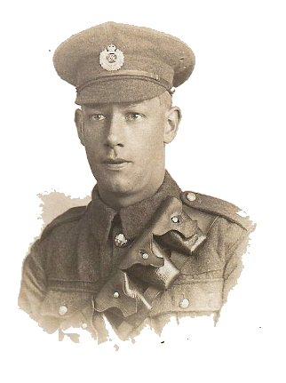
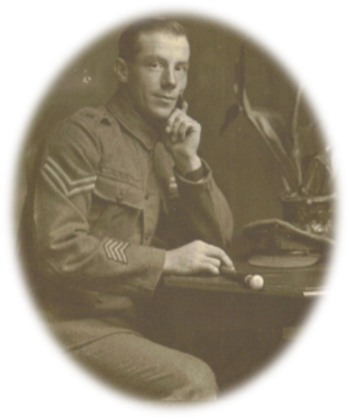
How was the Great War of 1914-1918 fought?
Aims
All will be able to describe why soldiers went to war, what propaganda is and how the war is fought
Most will be able to explain how the war was fought and be able to explain whether propaganda was effective as a weapon of war.
Some will be able to analyse the brutality of war and be able to explain the differences between the theory and reality of the Battle of the Somme.

Slide 2
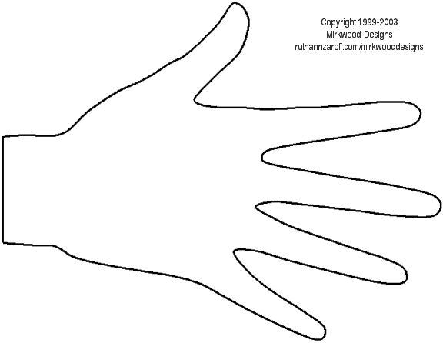
Starter
Why did Great War start in 1914?
Draw around your hand in your book.
On each finger write down 1 reason why
the Great War began.
HINT: look at last sessions work!

Slide 3
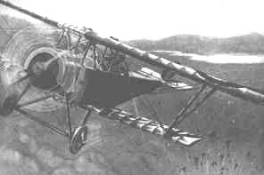
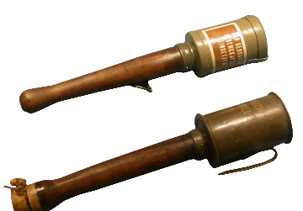
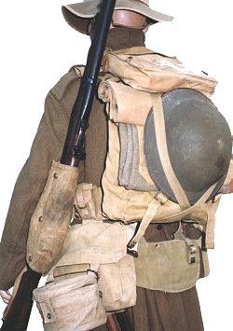
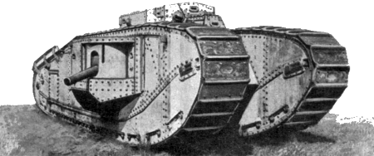
What is needed to fight a TOTAL WAR?

Slide 4
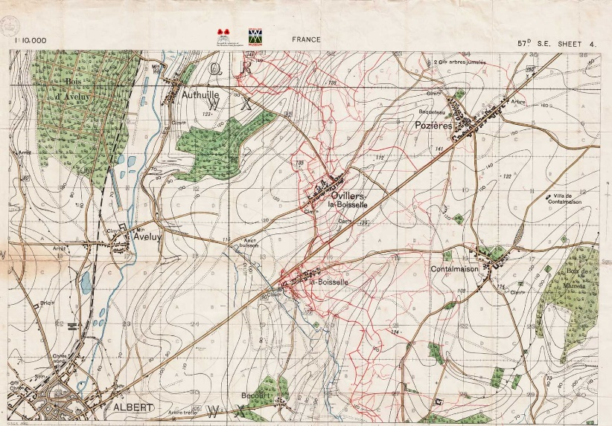
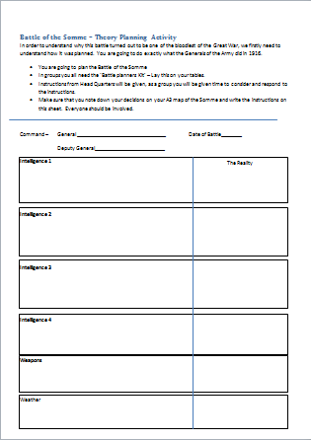
Task 1 - What happened at the Battle of the Somme 1916?
For this task you need to be put into groups of 4 or 5
You need;
A3 Map
A4 Planning Booklet
A blue and red pencil or pen
For this activity you need to work as a group, discuss ideas and complete the various activities as instructed.

Slide 5
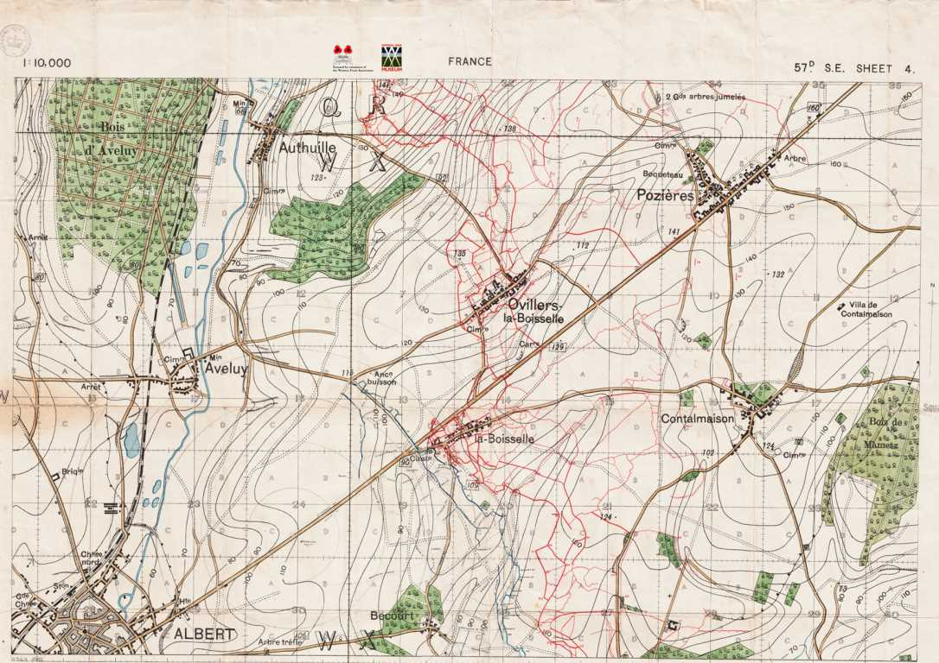

Slide 6
Objective Check;
Think, Pair and Share
To understand how the war was fought
Think of 2 ways in which the war was fought, perhaps weapons used etc..
Pair - discuss with a partner and exchange ideas
Share - Feedback to the rest of the group
To be able to explain the differences between the thoery and reality of the battle of the Somme
Think - Think of how the theory of the battle of the Somme was different to what actually happened.
Pair - Discuss with a partner your ideas
Share - Feedback to the rest of the class

Slide 7
Task 2 - How effective was propaganda in recruiting men to fight in the war?
What does Propaganda mean? (key word sheet)
Activity
You will be given 1 propaganda poster, you need to annotate the poster (writing on it what it shows - label different parts of it and say what it is) then complete the questions on the sheet.
Then complete the following;
Why do you think the Government used propaganda? What were they trying to achieve?
How useful are propaganda posters to historians who are researching the war?
Explain what the historians could learn from the posters about the war...
Extension - What are the limitations with propaganda? (what are the problems with it?)

Slide 8
Objective Check
Think, Pair and Share
To understand what propaganda is and how effective it was
Think - what is propaganda, how it is used and how it is effective
Pair - Discuss with a partner your ideas
Share - feedback to the rest of the class

Slide 9
Plenary
Watch the clip of the '90th anniversary of the Battle of the Somme'
Why do you think this particular battle is being commemorated 98 years later?
Are we right to commemorate it? Explain
The Somme
Next year - is the 100th anniversary of the battle

Slide 10
HWK
Research WW1 Trench System - need a image
WW1 trench life

