Slide 1
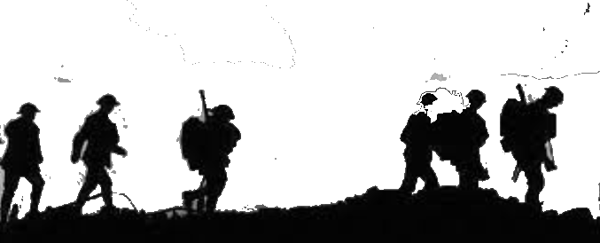
What were long term causes of the Great War 1914-1918?
All will be able to describe the long term causes of the Great War
Most will be able to explain which causes were the most important and how it caused the Great War
Some will be able to analyse the causes and select the most important

Slide 2
Think, Pair and Share
Why do countries go to war against each other?

Slide 3
How are these factors linked? Draw onto the board any links you can see?
Jealousy
Broken agreements
Rivalry
Anger
Why do countries go to war against each other?
Mistrust
Religious differences
Fear
Competition
Suspicion
Greed - want something the other has got e.g. land, oil, people
Political differences

Slide 4
Broken agreements
Jealousy
Rivalry
Why do countries go to war against each other?
Religious differences
Mistrust
Competition
Suspicion
Anger
Fear
Greed - want something the other has got e.g. land, oil, people
Political differences
What does this diagram tell you about the causes of war?

Slide 5
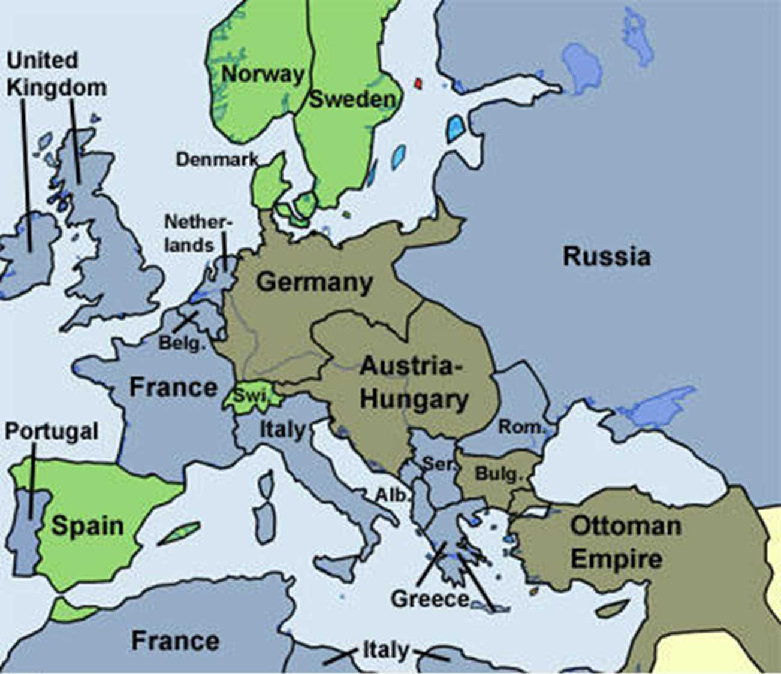
Task 1
In 1914, World War One broke out, sparked off by the assassination of Archduke Franz Ferdinand of Austria. Most of the countries of Europe declared war other countries and pretty soon Europe found itself in a two-way fight.
But the causes of war go back many decades before 1914. In pairs you will now look at the LONG Term causes
Sort – Put the cards you have into chronological order (when they happened). Not all cards will have a date, so ignore the ones that don’t (for now).
Discuss – What do you notice about the dates?

Slide 6
Discuss – In your groups find three examples of cards that are related causes. They might lead into each other or might be very similar.
Write – Note down these causes down in your book and explain how they are related.
There are four main categories of long term causes, what are they? – write them down in your book.
Military
Alliances
Imperialism
Nationalism

Slide 7
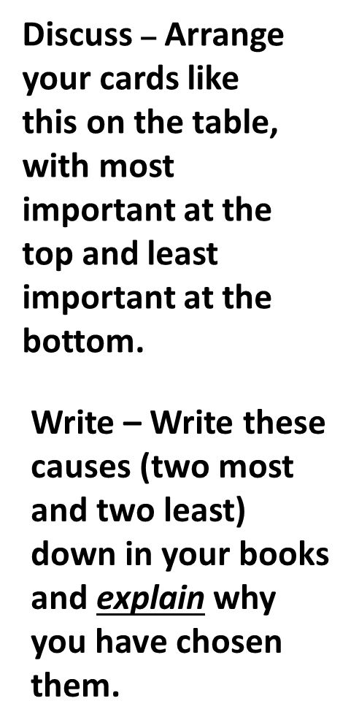
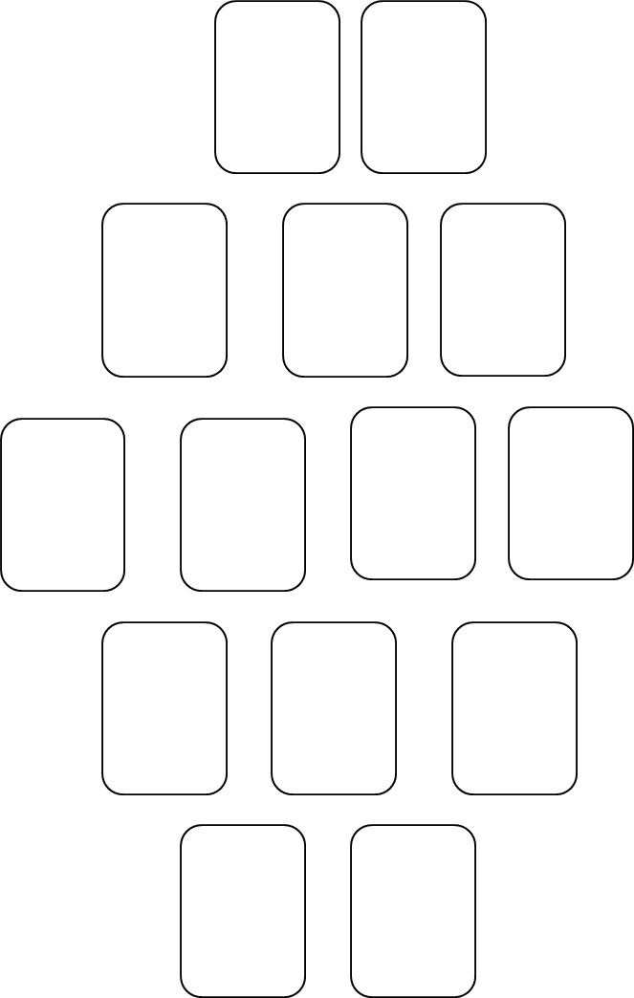
Extension
Was making so many alliances a good decision for the European Great Powers? If so, why? If not, why not?

Slide 8
Video - Approach to war
Write the answers on the A4 sheet - the questions are in order and the bold headings on the sheet match the chapters on the video.
Approach to war Video

Slide 9
Plenary - Could the war have been avoided?
Resolving Conflict - Citizenship
1.After the assassination of Ferdinand, what could be done to stop the crisis developing into open war? Working in pairs or 3’s make 2 or 3 recommendations to secure peace.
2.What organisations exist today to help stop conflicts or arguments between countries developing into wars? Do they do good job?

