Slide 1
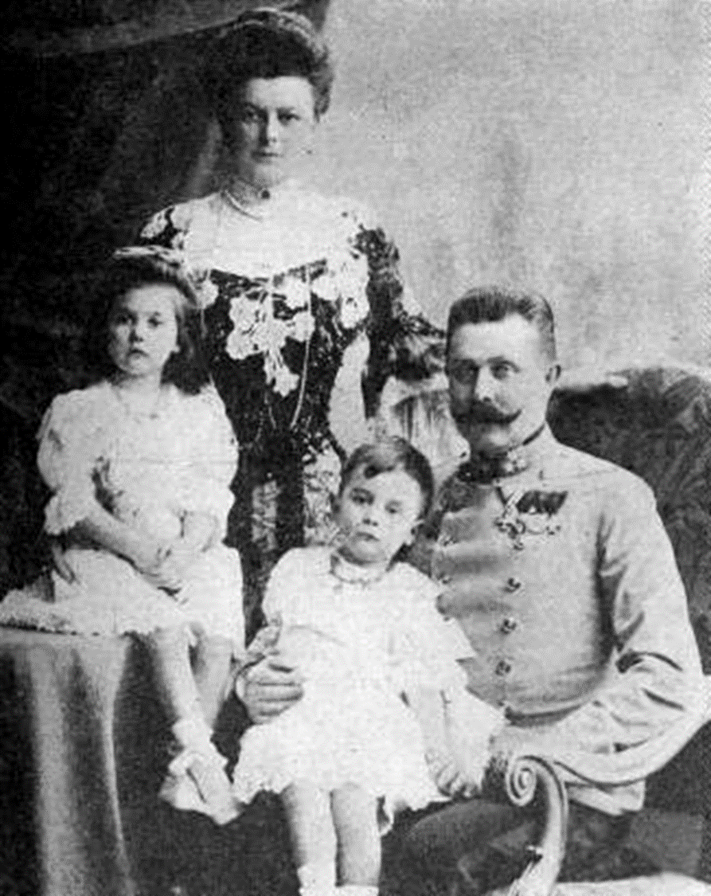
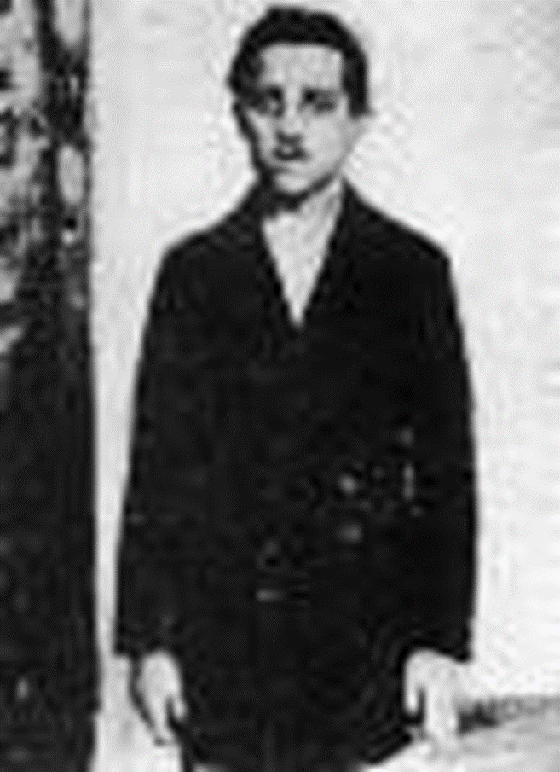
What were the short term causes of WW1?
All will be able to describe the short term causes of war
Most will be able to explain how the assassination of Franz Ferdinand led to war
Some will be able to analyse the causes and select the most important

Slide 2
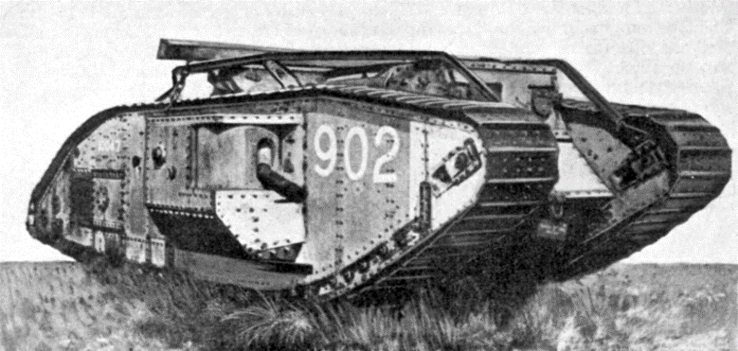
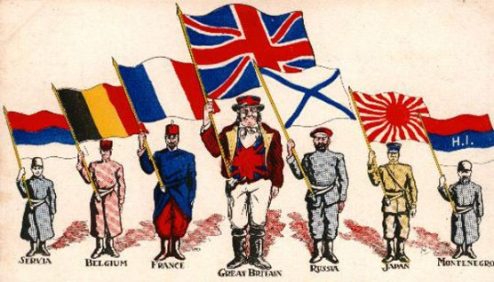
M
A
I
N

Slide 3
Militarism
Alliances
Imperialism
Nationalism

Slide 4
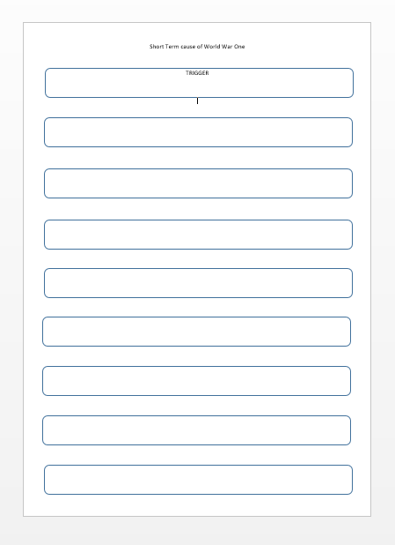
Task 1 - Short Term causes
Using the A4 sheet you are going to record the short term causes of war as we go through the powerpoint

Slide 5
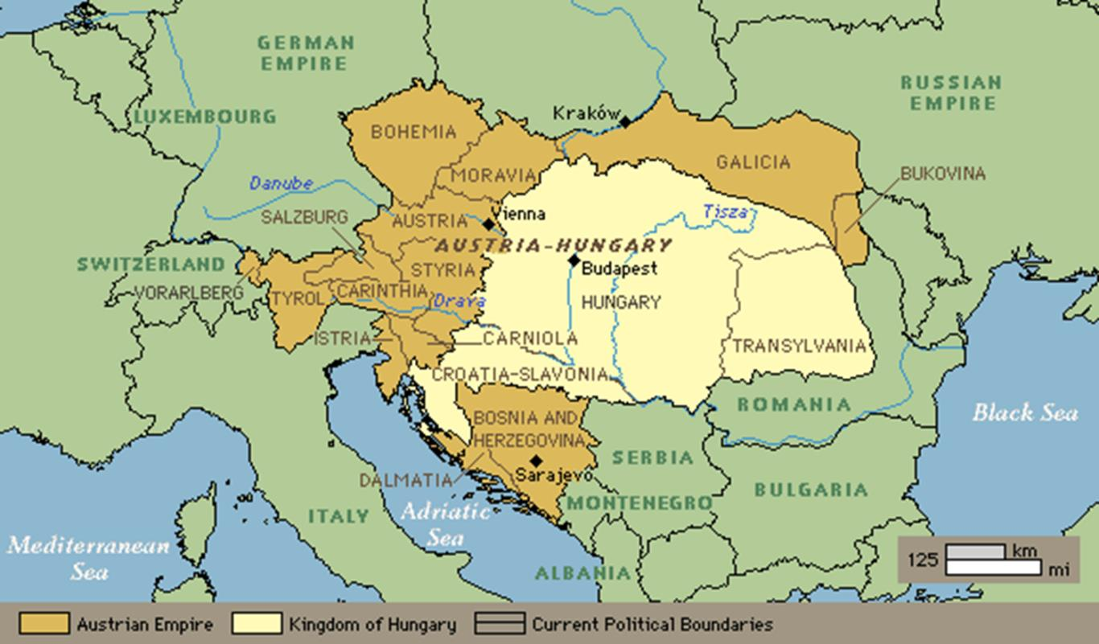
Task 2 - What happened in Sarajevo in 1914?
Write a police witness report describing what happened on June 1914 in Sarajevo – use the key words below to help you.
Extension - What would Gavrilo's justification be for assassinating the Archduke?

Slide 6
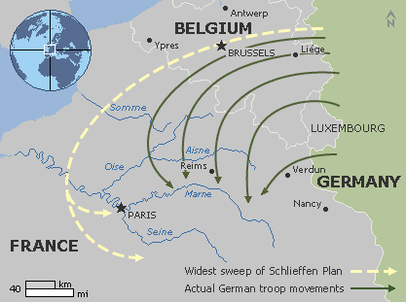
Task 3 - From Assassination to War....
Go back to your flow chart - What happened on 3rd August 1914?
Schlieffen Plan
Using the A4 sheet
Read the information and complete the activities at the bottom of the sheet
Extension - Why did they invade Belgium to get to France when they could have gone straight from Germany through to France?

Slide 7
A bit like charades or Pictionary – I am going to give a volunteer one of the key words or events we have looked at today and they must describe without saying the word/act it/draw it. The first to guess wins!

