Slide 1
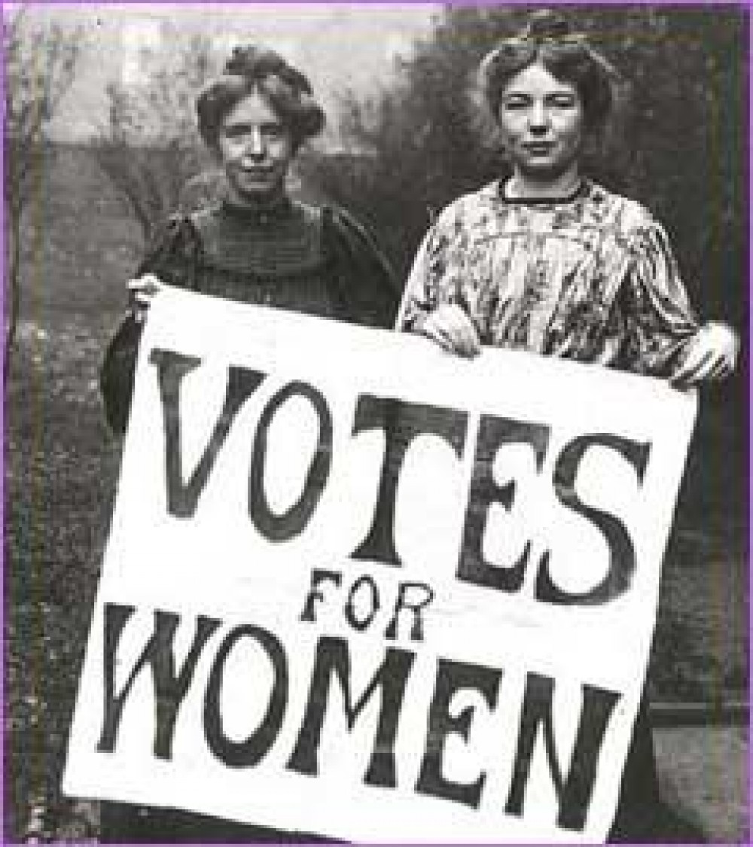
Who were the Suffragettes?
All will be able to describe who the Suffragists / Suffragettes were
Most will be able to explain the methods the Suffragettes used to campaign
Some will be able to analyse sources and evaluate which methods would gain/lose support
March of the Women - play as students come in

Slide 2
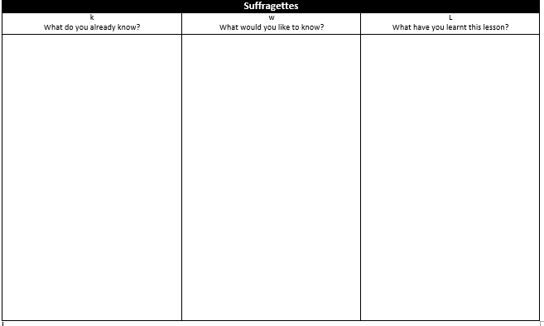
Starter
Suffragettes
Complete the first 2 columns

Slide 3
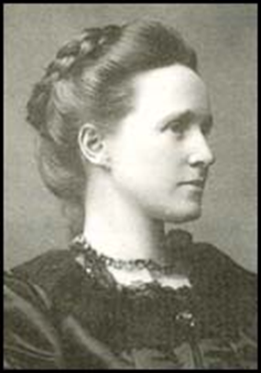
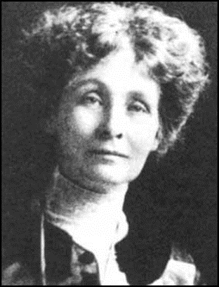
Task 1 Who were the Suffragists / Suffragettes?
As a class, you will be split - 1 half will investigate the Suffragists and the other will investigate the Suffragettes
Using your information sheet - fill in your section on the worksheet
You will then feedback your information to the rest of the group
Extension - Who do you think would be the most successful in winning support?
Millicent Fawcett
Emmeline Pankhurst

Slide 4
DVD

Slide 5
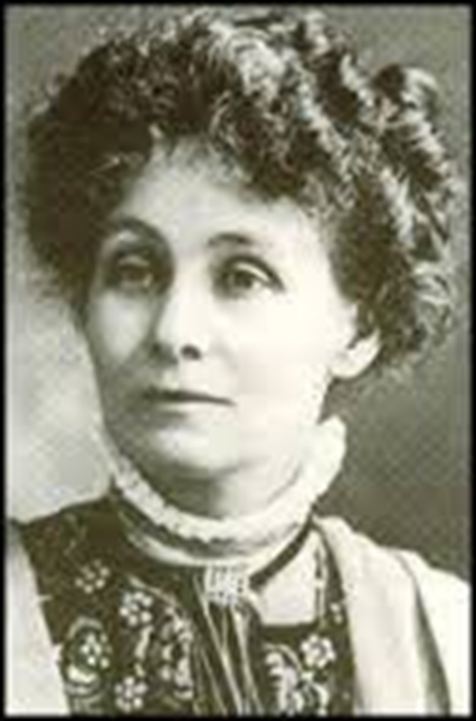
Task 2 - How did the Suffragettes campaign?
You are Emmeline Pankhurst, leader of the Women’s Social and Political Union.
You have £5,000 that you and fellow Suffragettes have raised to try and win the vote.
How will you and your partner spend the money
Fill in the A4 sheet and then complete the following questions.
1. Out of all of the Suffragette activities, which one do you think would be most successful in gaining support? EXPLAIN
2. Which activities do you think would increase opposition to the Suffragette movement? EXPLAIN
3. What activities do groups today still use to protest? EXPLAIN
Extension - How would Mrs Pankhurst justify her methods? what reasons would she give for such harsh methods?

Slide 6
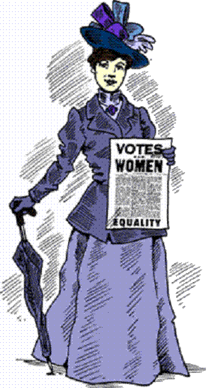
Task 3 - What do the sources say about the Suffragettes?
In pairs, using the sources booklet, complete the source analysis table
Extension - Why were men / government against the Suffragettes?

Slide 7
Bad Romance - Suffragette Style
Suffragette Song
Watch these videos - Do they help to fill in the 3rd column of your KWL grid

Slide 8
Plenary
Complete the last column

