Slide 1
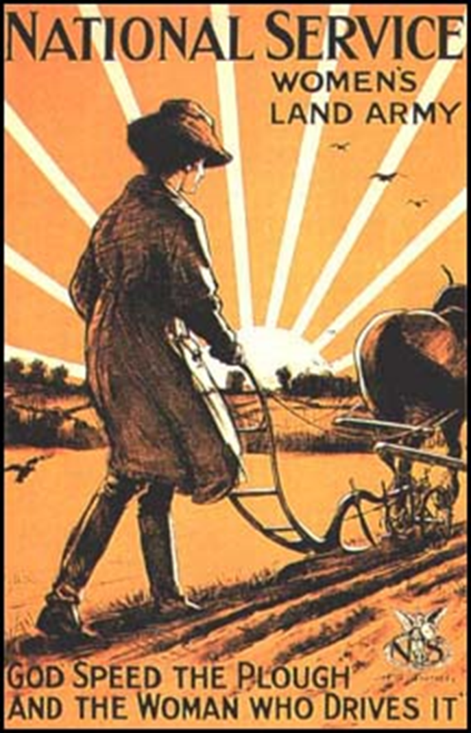
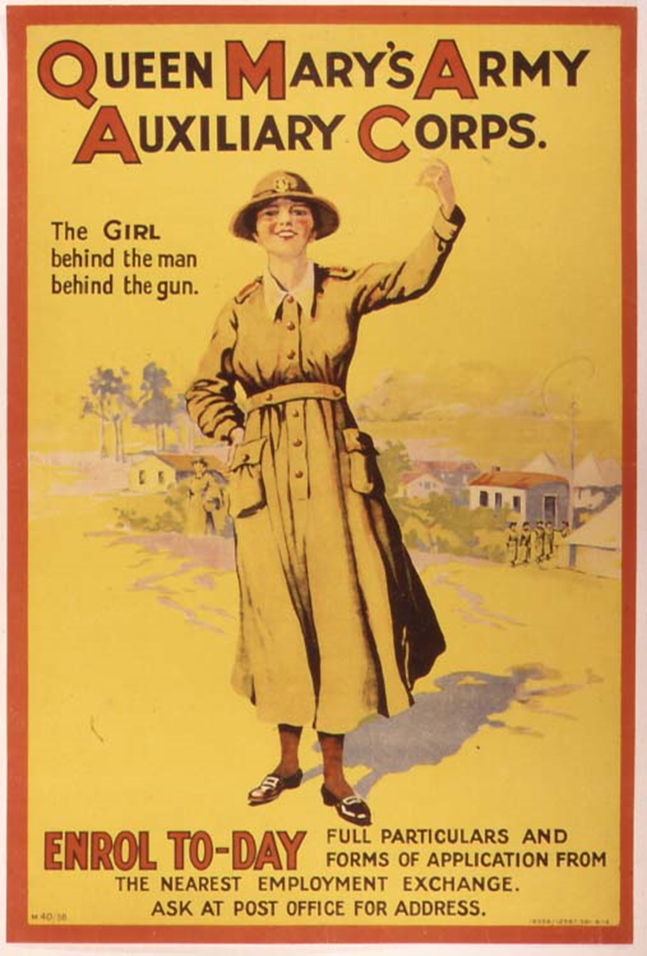
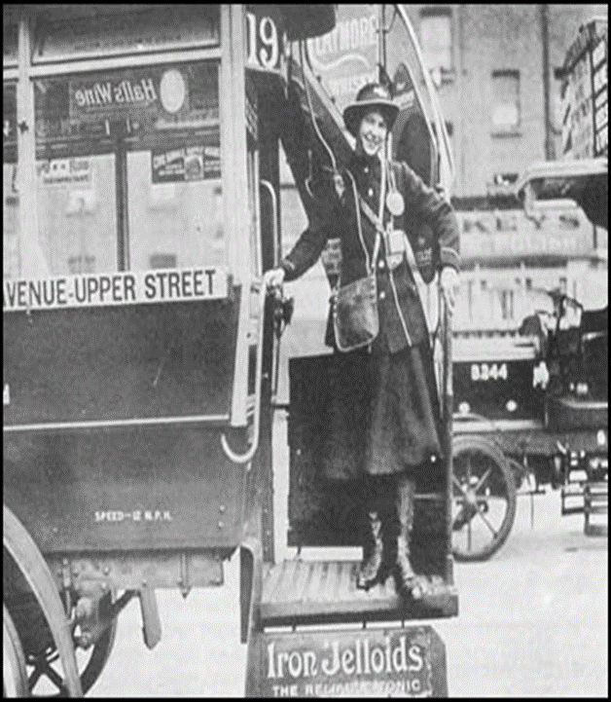
What was the role of women in the Great War?
All will be able to describe what the Suffragettes did at the beginning of the war
Most will be able to explain the role women had during the war
Some will be able to analyse and evaluate the contribution women made during the war

Slide 2
Starter
Starter
What kind of jobs do you think women did before the war?
List ideas
Suffragette is not a job!

Slide 3
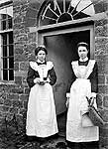
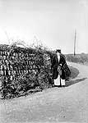
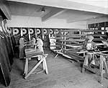
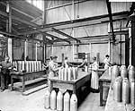
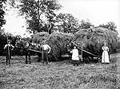
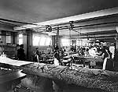
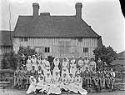
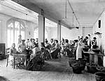
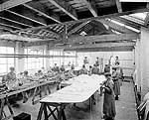
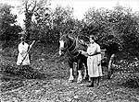
Task 1 Jobs for the girls!
Using the A4 sheet - cut out the 12 sources and sort them into the 2 columns - once happy stick them in
Jobs done BEFORE 1914
Jobs done AFTER 1914
Women in 'safety' clothes at Royal Gunpowder Factory
Taken: 1914-18
Women domestic
servants
Taken: 1896-1920
Women painting
aircraft wings
Taken: 1916
Women nurse
wounded soldiers
Taken: 1918
Women sewing
aircraft wings
Taken: 1918
Women preparing fruit
Taken: 1910
Women farm workers
Taken: 1904
Women prepare shells
Taken: 1917
Women's Land Army
Taken: 1917-18
Women sewing goods
Taken: 1900
Woman Post-lady
Taken: 1901
Women packing fish
Taken: 1896-1920

Slide 4
Task 2 - How did women contribute to the war effort?
Using the A4 sheet, complete the questions below.
1. How did the Suffragists/ Suffragettes react to the outbreak of war? Why did they do this?
2. Why were employers and unions reluctant to employ women in manufacturing?
3. What persuaded employers to take on female workers?
4. Make a spider diagram of the jobs women were now expected to do.
Extension - What other new areas of society were women now getting involved in? (consider what had been men only)

Slide 5
Task 3 - Role of Women in war time - Flow chart
Using the A3 information sheet - create a flow chart showing how the life of women changed from 1914-1918
Recruitment and Propaganda
Munitions
Transport
Do this for each section on the sheet - add key info/ terms and images
Extension - How would this change in position help women get the vote?

Slide 6
Think, Pair and Share
Plenary
'The war got in the way of the Suffragette campaign - causing them to suspend their protest'
AGREE OR DISAGREE
Explain

