Slide 1
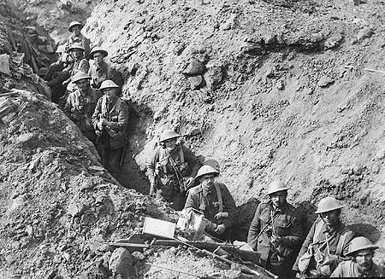
How do we know what life in the trenches was really like?
Lesson objectives
· All will – have a basic understanding of the main problems of life in the trenches and considered the usefulness of a number of primary sources.
· Most may - as above but more detailed subject knowledge of life in the trenches and a greater understanding of the range of problems. Also have a good understanding of the uses and limitations of some sources.
· Some could - as above but with a greater understanding of problems in trenches and a very clear understanding of usefulness and reliability of sources. Appreciate what other types of sources needed to gain a fuller understanding.
"They left for war as boys never to return as men."

Slide 2
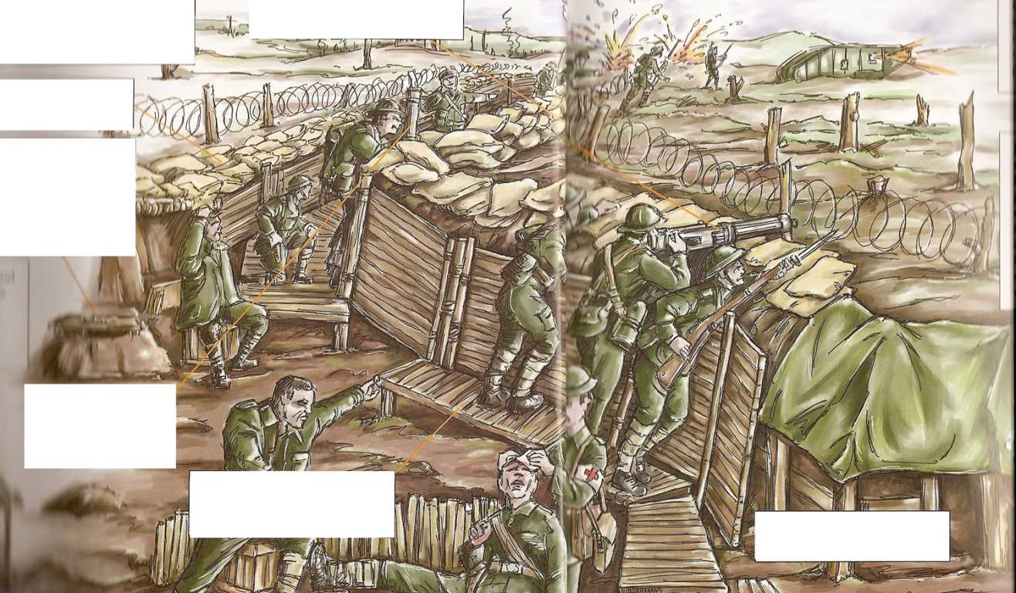
Starter
You have been given an image of a trench
Match the labels to the parts of the trench.
Toilet
Soldier
Machine Gun
Duckboards
Fire Step
Barbed Wire
Sandbags
answers on the next slide
Periscope (used for spying on the enemy)

Slide 3
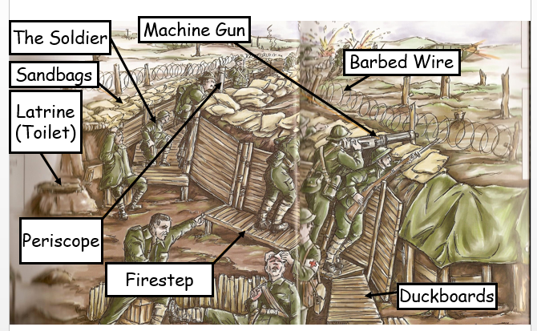

Slide 4
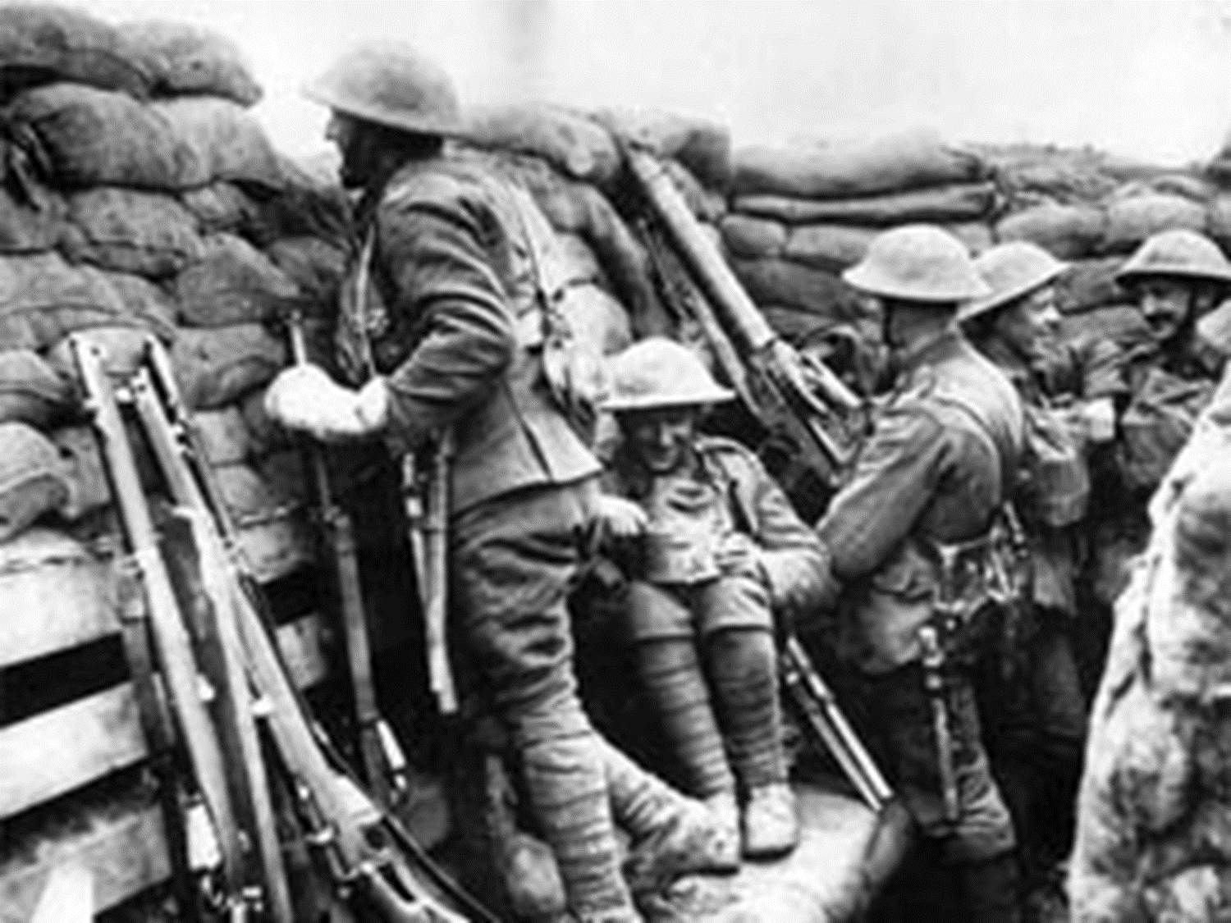
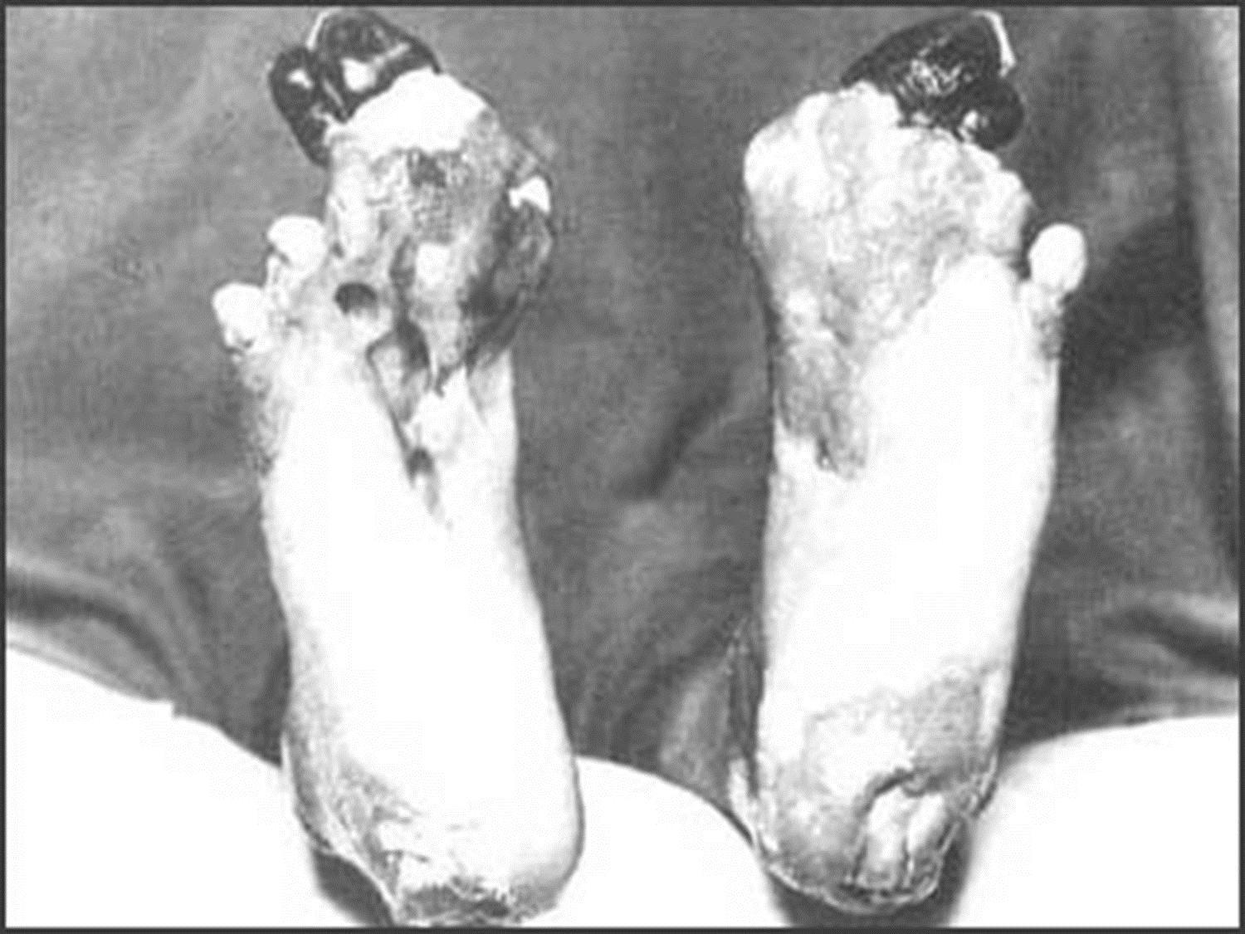
After you have seen the Slide show - what do you think trench life was like?- note down words to describe trench life.
Answers on the next slide
TRENCH
LIFE

Slide 5
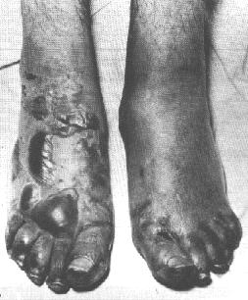
Rats
Unhealthy
Dangerous
Muddy
TRENCH
LIFE
Disease
Shelling
Psychologically damaging
Fear
Hunger
Boredom

Slide 6
Video
Complete the video question sheet as we watch the video
Trench Life

Slide 7
Task 1 - What do the artefacts teach us about life in the trenches?
As a class you will analyse the contents of an artefact's box, in turn you will be given an object in your pairs for you to decide what it was, all of these items were used by soldiers in the trenches.
What you should aim to do is the following.
Sketch the object
Write down what you think it is
Be prepared to report back to the class what you think it is
Your teacher will give you the answers after you present your ideas.
Whilst you do this you can also try on the helmets/ caps and hold the rifle

Slide 8
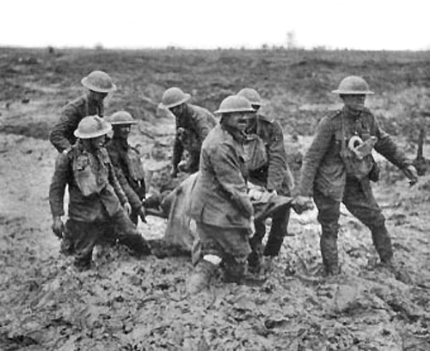
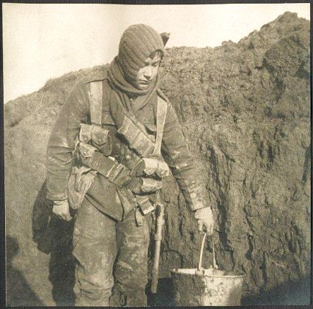
What does the evidence tell us about life in the trenches?
Assessment
Next week is your assessment, take the A3 sheet home and make notes on what trench life was like. Underline key facts about life in the trenches, what the soldiers thought about life in the war.
Bring this back next week, you can use notes within your assessment.

Slide 9
Plenary –
What was the worst aspect of life in the trenches? Ask students to justify answer
Think, Pair and Share

