Slide 1
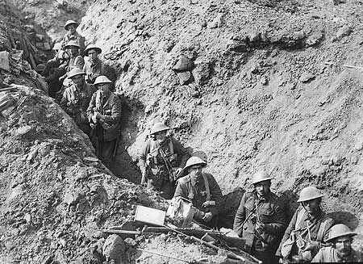
How do we know what life in the trenches was really like?
Lesson objectives
All will be able to describe what life was like in the trenches and begin to use sources to prove ideas
Most will be able to explain what life was like and be able to analyse primary and secondary sources
Some will be able to analyse the sources and consider how useful they are in studying life in the trenches.

Slide 2
What was the worst aspect of life in the trenches? Ask students to justify answer
Think, Pair and Share

Slide 3
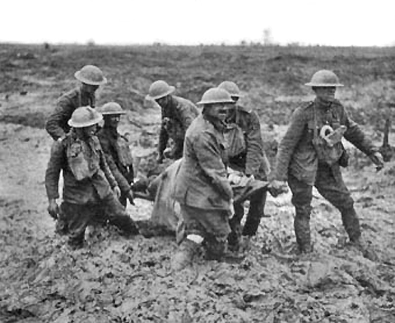
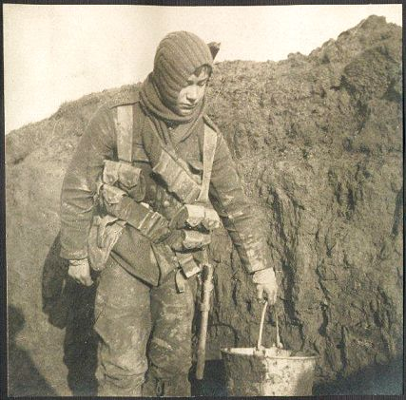
What does the evidence tell us about life in the trenches?
Assessment
See A3 sheet and question sheet provided. For Q1, possible problems to describe and explain are:
trench foot trench fever shell shock
mud rats lice
boredom bad food noise

