Slide 1
How did the Great War end? What should happen to Germany?
All will be able to describe how the war ended and what happened to Germany
Most will be able to explain key aspects that led to the end of the war and feelings of Germany, Britain, France and USA
Some will be able to analyse the events and consider the consequences of the Treaty of Versailles

Slide 2
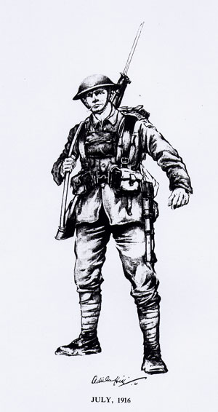
Starter
Spelling Test
Spelling Test
Alliance
Propaganda
Nationalism
Imperialism
Western Front
Militarism
Infantry
Artillery
Allies
Trench Foot
Write the numbers 1 - 10 in the back of your exercise book.
Move the soldier to reveal the answers

Slide 3
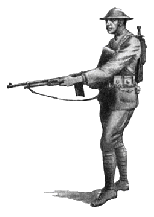
Task 1 – How did the Great War end in 1918?
This task looks at the events that brought an end to the Great War.
In groups of 3 or 4 - you are going to work together to record the events that brought the end to the war.
Each person needs to write in their book
Once you have completed your timeline / events leading to the end of the war, complete the following task.
Why did Germany surrender? Identify (list) at least 3 reasons. - Explain with details. Remember use your key word sheet to check spellings.
Extension: Would Britain, France and America all have the same opinion about how to treat Germany? Explain your thinking.

Slide 4
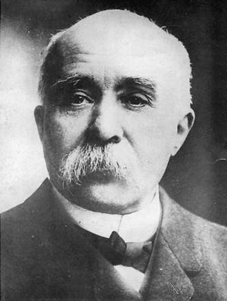
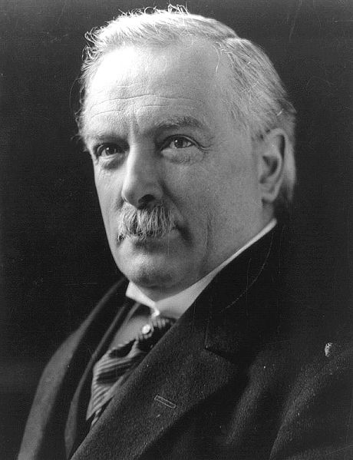
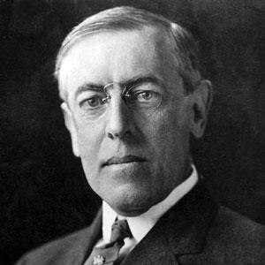
Woodrow Wilson
USA
George Clemenceau
France
David Lloyd George
Britain

Slide 5
Task - 2 How would you punish Germany?
Decision Making task
You are going to do what the world leaders did in 1919 - decide Germany's fate!
Extension work
What problems did you have in coming to an agreement over the punishment for Germany?
What aspect of your treaty do you think Germany would have hated the most and why? Explain fully

Slide 6
Task 3 – What actually happened to Germany?
World leaders met from January to June 1919 to decide how Germany was punished - they came up with the Treaty of Versailles. (treaty = agreement)
What territory did they lose?
What were they made to accept?
Germany 1918 - 1919
Treaty of Versailles
What compensation did they pay and what would it pay for?
What military did they lose?
Why did Germany oppose it?
Why did Germany accept it?
Extension - With all these punishments forced on Germany, what problems might occur in the future? Can you think of any events to prove your ideas?

Slide 7
Plenary
Using the module booklet from the first lesson,
complete the module review.
What has been the most interesting aspect of this module for you?
Look back through your work, write down 2 ways in which you can improve in the next History module.

Slide 8
Module review:
1. What have you most enjoyed learning about this module?
2. Which activity have you most enjoyed doing?
3. How do you think you can improve in your next module?

