Slide 1
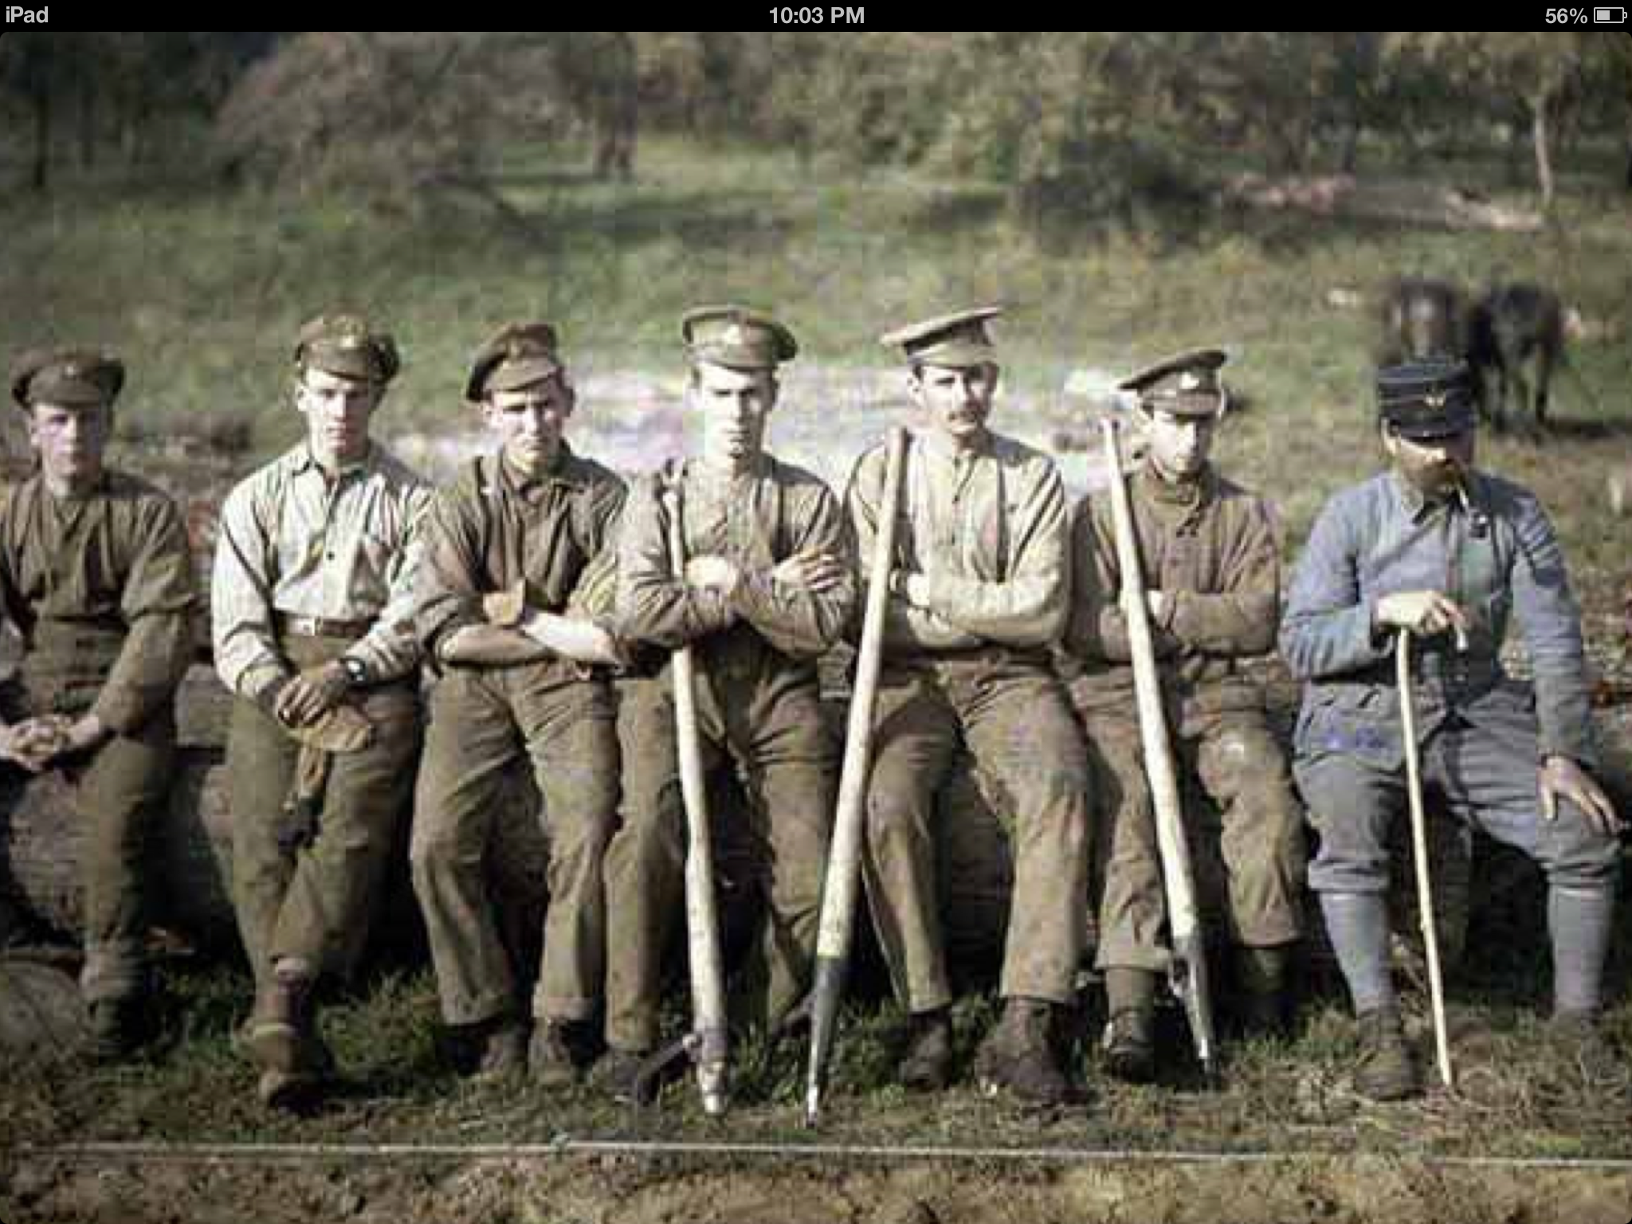
Battle of the Somme Why was the Battle of the Somme so bloody?

Slide 2
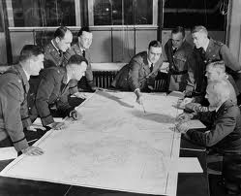
In order to understand why this battle turned out to be one of the bloodiest of the Great War, we firstly need to understand how it was planned.
You are going to do exactly what the Generals of the Army did in beginning of 1916.
You are going to plan the Battle of the Somme
In groups you all need the ‘Battle planners Kit’ – Lay this on your tables.
Instructions from Head Quarters will be given, as a group you will be given time to consider and respond to the instructions.
Make sure that you note down your decisions on your A3 map of the Somme.

Slide 3
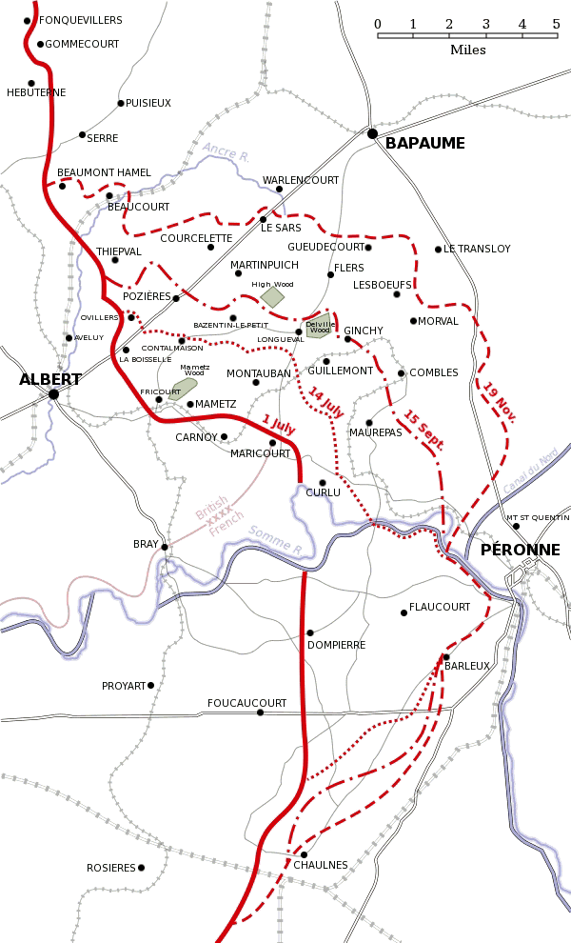
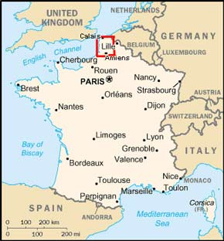
In order for this battle to take place, we need a location.
Somme – France
Between the towns of
Albert – and Bapaume.

Slide 4
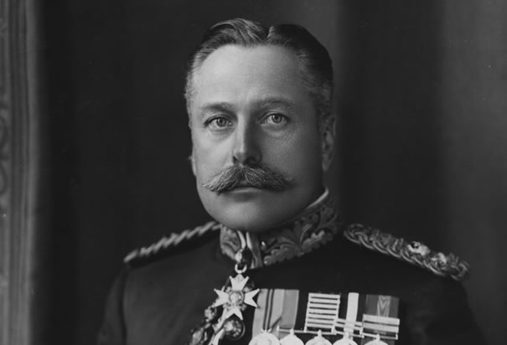
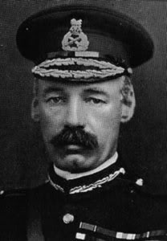
Fact File
General of the British Forces: Sir Douglas Haig - Deputy: General Henry Rawlinson in charge.
The Battle date
from 1st July 1916 –
Somme - France

Slide 5
Intel. (intelligence)
We have word from the French;
The Germans are on high ground with a good view of the attacking forces.
Action - Circle / shade and annotate in red
‘La Boiselle’ as being German ground
Using your mapping skills – how do you know that La Boiselle is on high ground?

Slide 6
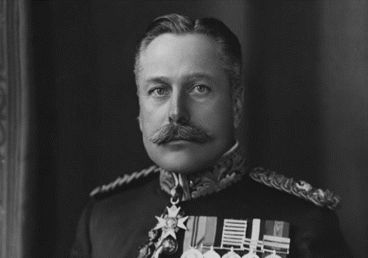
Intel…
Reconnaissance – The RFC –Royal Flying Corps report,
“Their defences had been in place since 1914, which means their trenches were deep and fortified with concrete”
Action – Using //// marks – mark across your shaded area – this signals strong defences.

Slide 7
Intel…
We, the British and French forces consist of 27 divisions (about 750,000 men).
The Germans have 16 divisions (about 450,000 men).
We are stationed between Aveluy and Becourt wood.
Action – Mark on British positions using a Blue pencil – Circle and shade where the British are.
Again – how do we know that the British position was flat ground?

Slide 8
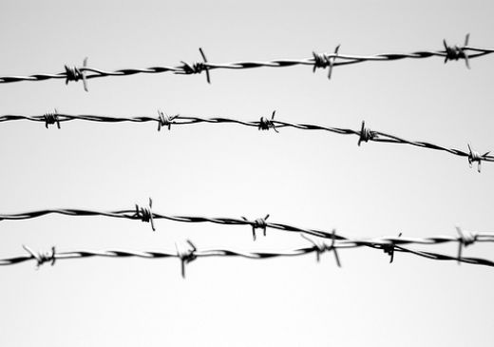
Intel….
The Germans had stretched barbed wire like a band more than 30 metres wide along their front line (this where they face us). It was almost impossible to break through)
Action – Using xxx marks – mark on 300 m (3cm on your map) in length, these are the barbed wire sections.

Slide 9
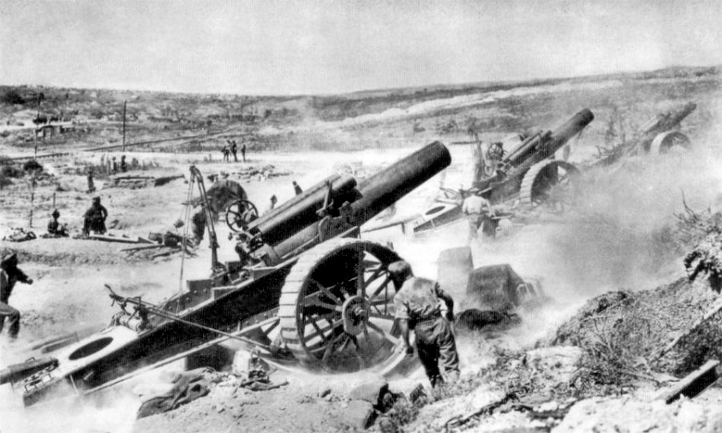
Weapons
Heavy Artillery will pummel German positions for 7 days. 1.5 million shells to be used before the 1st July. All barbed wire to be cut.
All German Machine gun posts will be destroyed.
Trenches will be destroyed by a series of mines.

Slide 10
Action required
Plot on where you would position your Artillery Guns – use the following symbol to show on your map the location.
Artillery Guns -
Using arrows and plot on where you hope to fire your guns.
The Tunnelling Company will plant 1 mine in this area for you.
Using a symbol – decide where you would like your mine placing.
*

Slide 11
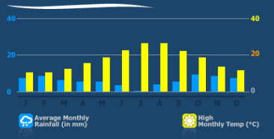
Weather
The outlook for weather for France in July is good.
The sun rises at 05:05am
Battle will commence at 07:30am

Slide 12
Planning Over
You will now start to fill in the ‘Reality’ Column of
your sheet!

Slide 13
What happened?
https://www.youtube.com/watch?v=g0V1yRrjMmM
What do you think will happen?
Barbed wire wasn’t cut
Heavy rain

Slide 14
What happened?
https://www.youtube.com/watch?v=0KzqzIR8x4U
6.20 - end
57,000 British casualties on the first day
about 1/3 of them killed

Slide 15
Why was the Battle of the Somme so bloody?

Slide 16
First reception in Britain…
Herbert Russell sent a telegram to Reuters about the Battle of the Somme (1st July, 1916)
'Good progress into enemy territory. British troops were said to have fought most gallantly and we have taken many prisoners. So far the day is going well for Great Britain and France.'

