Slide 1
PROPAGANDA is an attempt to influence the way people think- it is used by the government and big companies.
PROPAGANDA can be used to make you think something is good or something is bad.
It is done through posters, videos, radio, books etc.
Can you think of any modern examples of propaganda?

Slide 2
What can you see in this poster?
What is the message of this poster?
Who do you think this poster is aimed at?
What is the purpose of this poster?
Would this be effective propaganda? Why?

Slide 3
REMEMBER TO THINK ABOUT:
What can you see in your poster?
Who do you think your poster was aimed at?
What was the message of your poster?
What was the purpose of you poster?
Would this poster have been effective propaganda? Why?

Slide 5
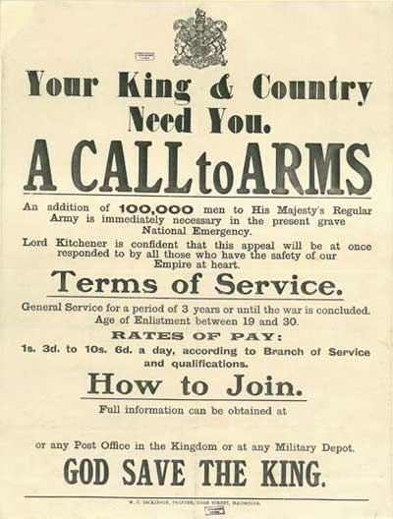

Slide 9
