Slide 1

At the end of World War One what problems remained that needed solving?

Slide 2
Problem, problems!
Here are some of the problems facing world leaders at the end of WWI. What advice would you offer them?
1. Who should pay for the destruction?
2. What could be done to help the economies of countries affected by the War?
3. How could future wars be prevented?
4. What could be done to help the families of the dead or injured?

Slide 3
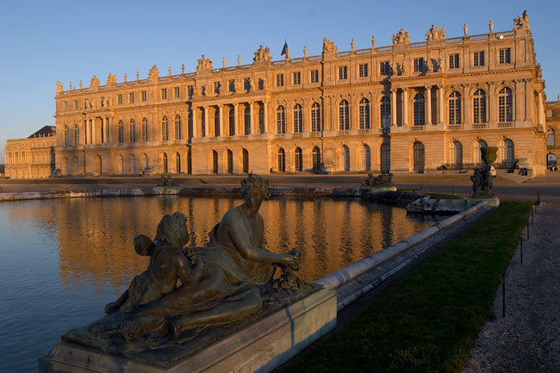
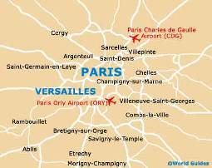
The Palace of Versailles

Slide 4
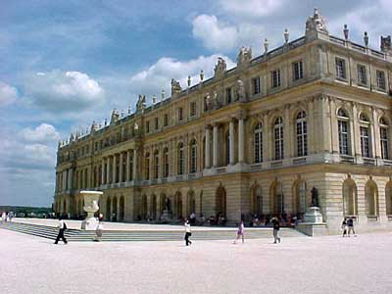
Did the Paris Peace Conference make a sensible settlement?
On 28 June 1919, exactly 5
years after the murders at
Sarajevo, which had sparked
off the First World War, the most
powerful men in the world met
in a magnificent palace just
outside Paris. The agreement
they signed became known as
the Treaty of Versailles.
The Palace of Versailles

Slide 5
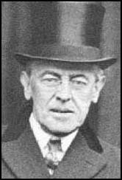
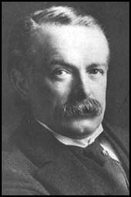
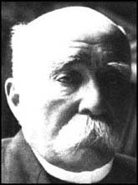
US President, Woodrow Wilson
Avoid future wars
Protect the British Empire
Make Germany pay!
French Prime Minister, Georges Clemenceau
British Prime Minister, Lloyd-George
What were the aims of the leaders?

Slide 6
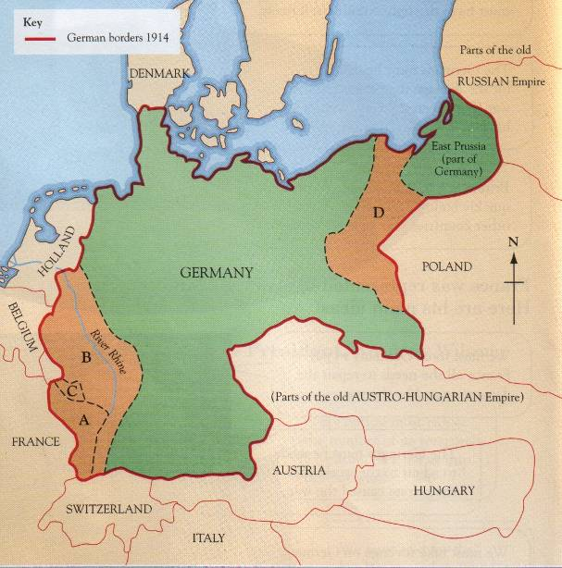
You are now representing the country given to you by your teacher. On your copy of the scorecard you need to select the options that will be best for your country. You will then compare your choices with what was actually decided. You will record your choices on your treaty document.
Problem | Option | Actual decision
1
2
3
4
5
6
7
8
9

Slide 7
Decision One
Area A on the map marks Alsace-Lorraine. Germany took this area from France in 1871. Should you … ?
a) return it to France
b) let Germany keep it
c) people who live in this area vote who they
want to control where they live

Slide 8
Decision Two
Area B on the map is the Rhineland. It is the place from which Germany can most easily attack France. Should you … ?
a) give it to France
b) let Germany keep it as before
c) let Germany keep it but insist that she never
puts any soldiers in this border area

Slide 9
Decision Three
Area C on the map is the Saarland. It is an important coal-mining part of Germany. Should you … ?
a) give it to France forever
b) let Germany keep it as before
c) let it be run by the League of Nations (an early
type of United Nations) for fifteen years and allow
France to have all its coal in those years

Slide 10
Decision Four
Area D on the map is part of Germany. Most people there are Germans but some are Poles. You want to make the new nation Poland, as strong as possible. Should you …?
give this land to Poland (the Polish Corridor)
and split Germany in two
b) let Germany keep it
c) let it be run by the League of Nations

Slide 11
Decision Five
You guess that Germany and Austria may want to join to become one country. They share the same language and culture. Should you … ?
forbid them to join as one nation
b) allow them to join as one nation

Slide 12
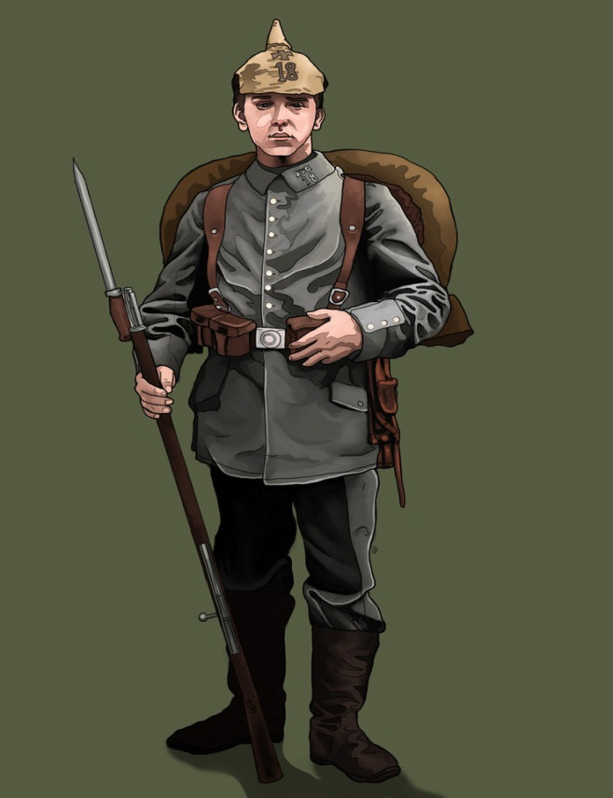
Decision Six
Should you … ?
allow Germany to keep a
full army, navy and air force
b) order Germany to cut down drastically on all
her armed forces
c) order Germany to cut down drastically on all
her armed forces including no airforce or
submarines and a ban on conscription

Slide 13
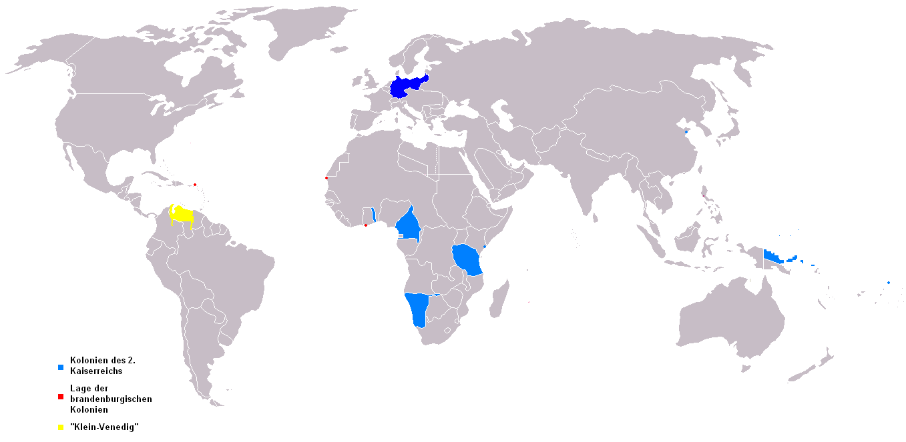
Decision Seven
Should you … ?
let the League of Nations run Germany’s overseas colonies
b) give Germany’s colonies to Britain and France
c) let Germany keep its oversees colonies

Slide 14
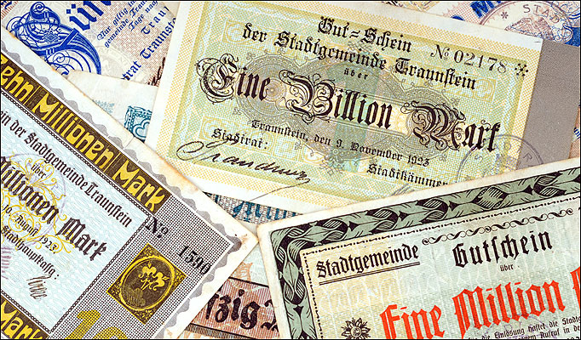
Decision Eight
Should you … ?
fine Germany a medium amount of money to pay for the damage done in the war - £2 Billion
b) fine Germany a large sum of money to pay for
the damage done in the war - £6 Billion
c) fine Germany a massive sum of money to pay
for the damage done in the war - £20 Billion

Slide 15
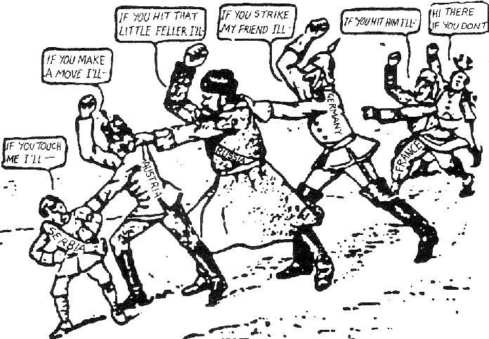
Decision Nine
Should you … ?
leave any mention of guilt or blame for the war out of the treaty
b) Britain, France, Russia, Germany and
Austria-Hungary take equal blame for the war
c) make Germany sign a War Guilt Clause
accepting all blame for starting the war

Slide 16

Decision One
Area A on the map marks Alsace-Lorraine. Germany took this area from France in 1871. Should you … ?
a) return it to France
b) let Germany keep it
c) people who live in this area vote who they
want to control where they live

Slide 17

Decision Two
Area B on the map is the Rhineland. It is the place from which Germany can most easily attack France. Should you … ?
a) give it to France
b) let Germany keep it as before
c) let Germany keep it but insist that she never
puts any soldiers in this border area

Slide 18

Decision Three
Area C on the map is the Saarland. It is an important coal-mining part of Germany. Should you … ?
a) give it to France forever
b) let Germany keep it as before
c) let it be run by the League of Nations (an early
type of United Nations) for fifteen years and allow
France to have all its coal in those years

Slide 19

Decision Four
Area D on the map is part of Germany. Most people there are Germans but some are Poles. You want to make the new nation Poland, as strong as possible. Should you …?
give this land to Poland (the Polish Corridor)
and split Germany in two
b) let Germany keep it
c) let it be run by the League of Nations

Slide 20
Decision Five
You guess that Germany and Austria may want to join to become one country. They share the same language and culture. Should you … ?
forbid them to join as one nation
b) allow them to join as one nation

Slide 21
Decision Six
Should you … ?
allow Germany to keep a
full army, navy and air force
b) order Germany to cut down drastically on all
her armed forces
c) order Germany to cut down drastically on all
her armed forces including no air force or
submarines and a ban on conscription

Slide 22

Decision Seven
Should you … ?
let the League of Nations run Germany’s overseas colonies
b) give Germany’s colonies to Britain and France
c) let Germany keep its oversees colonies

Slide 23
Decision Eight
Should you … ?
£6.6 Billion
fine Germany a medium amount of money to pay for the damage done in the war - £2 Billion
b) fine Germany a large sum of money to pay for
the damage done in the war - £6 Billion
c) fine Germany a massive sum of money to pay
for the damage done in the war - £20 Billion

Slide 24
Decision Nine
Should you … ?
Germany
leave any mention of guilt or blame for the war out of the treaty
b) Britain, France, Russia, Germany and
Austria-Hungary take equal blame for the war
c) make Germany sign a War Guilt Clause
accepting all blame for starting the war

Slide 25
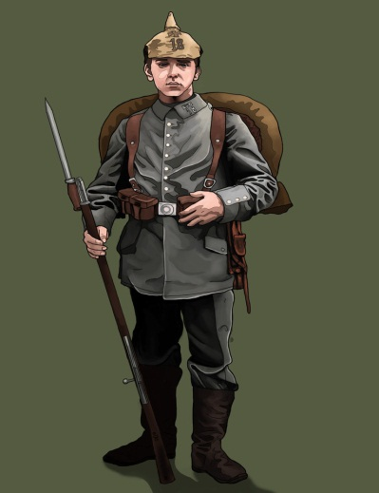


Problem | Option | Actual decision
1
2
3
4
5
6
7
8
9
£6.6 Billion
Germany to blame

Slide 26
HOW DO YOU
FEEL AS A
GERMAN

Slide 27
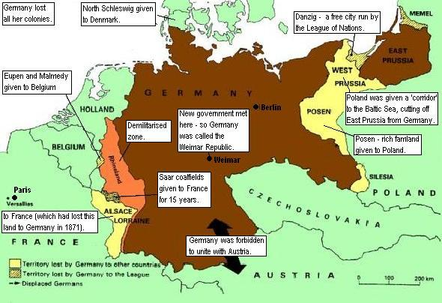
PLENARY
Film
‘Vengeance! German nation! Today in the Hall of mirrors the disgraceful treaty is being signed. Do not forget it. The German people will with unceasing labour press forward to reconquer the place among nations to which it is entitled. Then will come vengeance for the shame of 1919’ German Newspaper, 28th June 1919
What does this source tell us about how Germans felt about the Treaty?
What does it tell us about what Germans wanted to do about the Treaty?

Slide 28
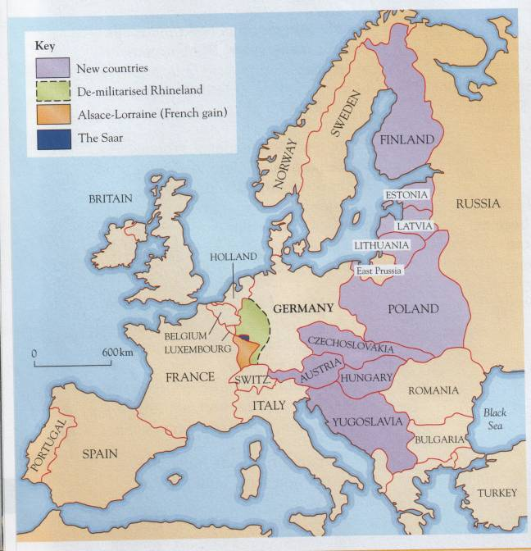
June 1919

