Slide 1
Poppies for Remembrance
The Great War
1914 to 1918

Slide 2
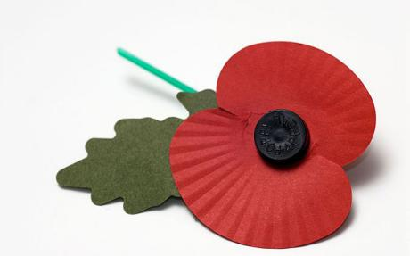
A poppy says “Thank you “

Slide 3
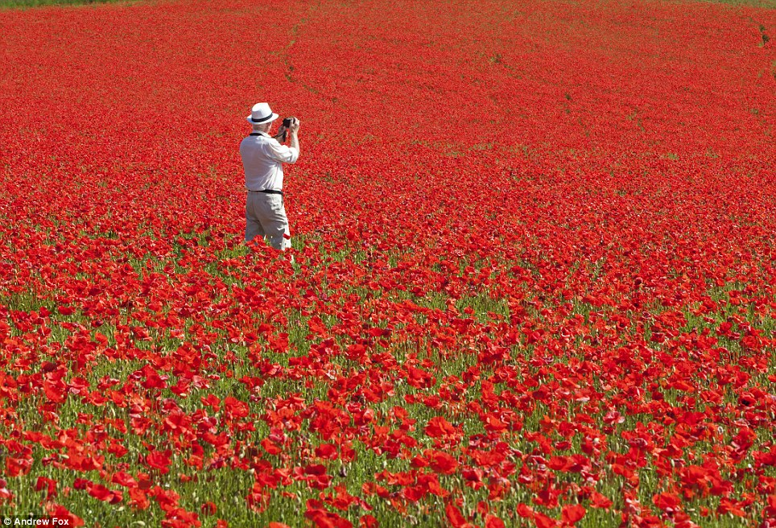
Poppies grow in the fields of France and Belguim every year where the fighting took place. They are said to represent all the soldiers who died.

Slide 4
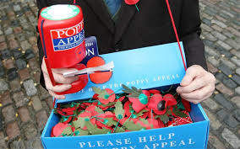
Every year in October and November, we all buy a poppy to say thank you.

Slide 5
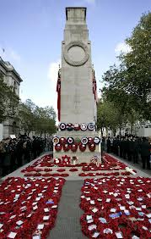
On November 11th at 11.00 am every year, a special ceremony is held to remember and say thank you to all the people who worked during the war.

Slide 6
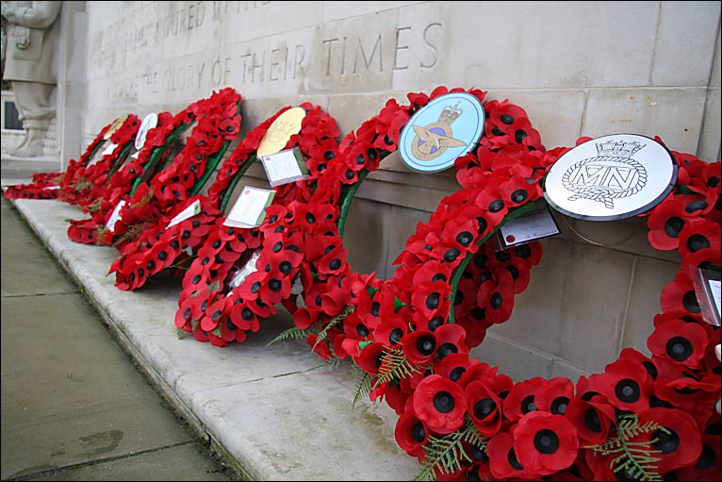
Poppy wreaths are laid down by the memorials and statues to say thank you.

Slide 7
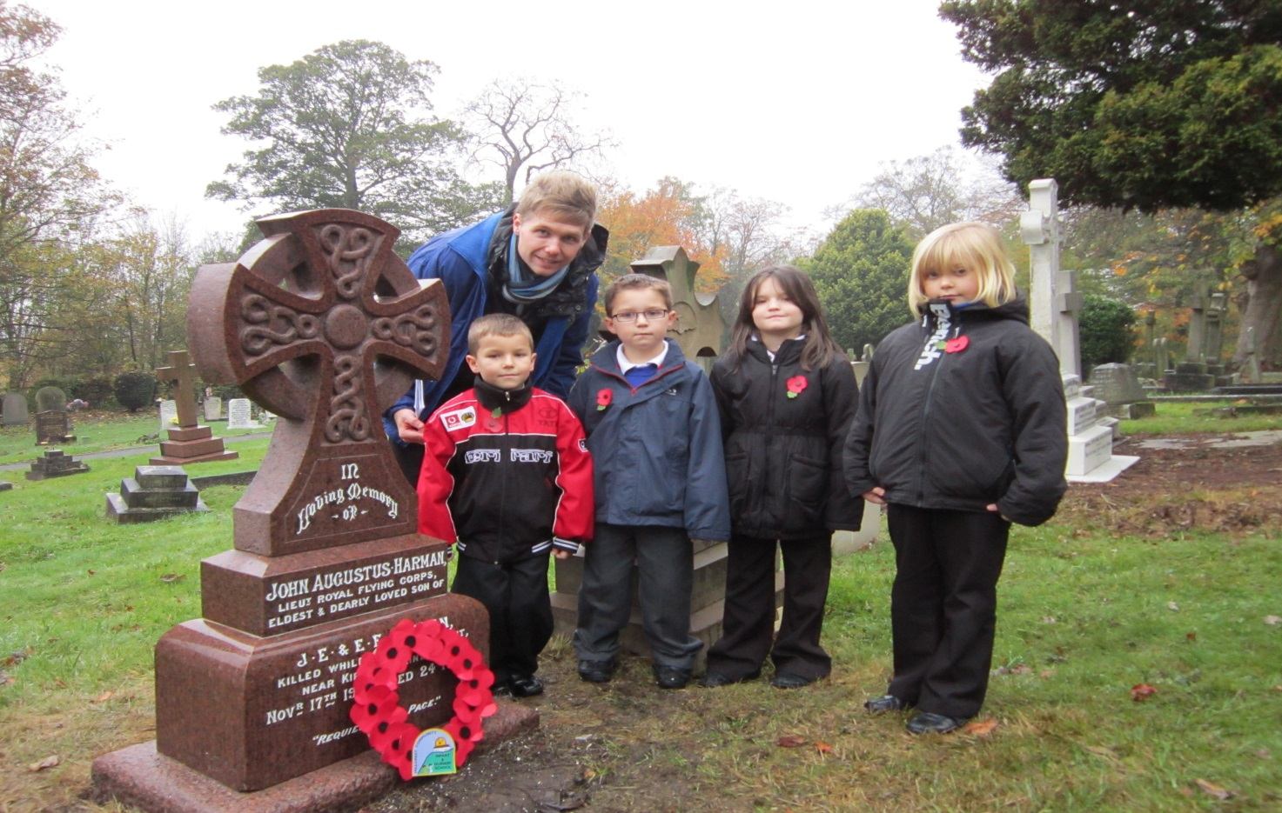
Our pupils and our teachers go and say thank you every year.

Slide 8
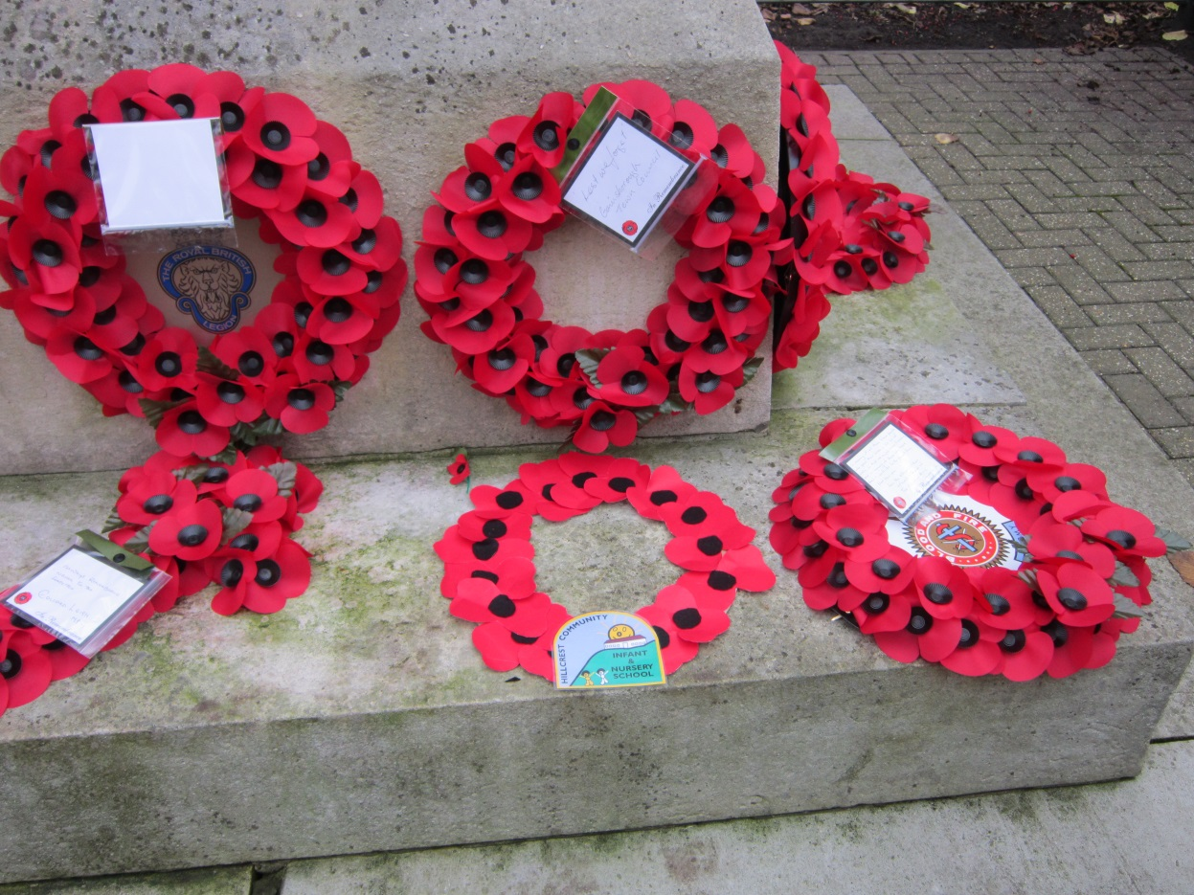
Can you spot our school badge on our poppy wreath ?

Slide 9
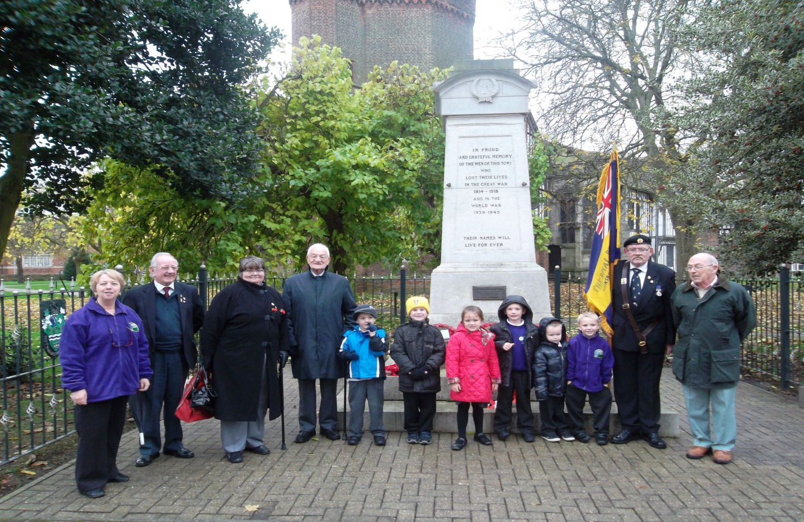
Mrs Kirman and some of our Year Ones went to a special service to say thank you.

Slide 10
Can you make your own poppy today to say thank you ?

