Slide 1
THE CHRISTMAS TRUCE
24th December 1914

Slide 2
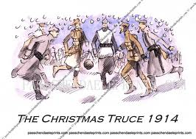
On the 24th December 2014, both German and British troops stopped fighting for Christmas

Slide 3
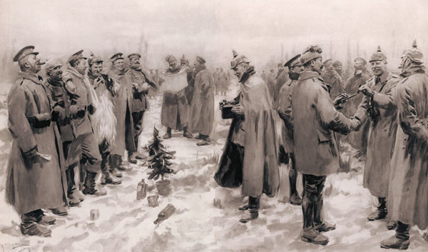
The start of the Christmas Truce
The Germans started to sing
Christmas hymns could be heard
The Germans sang Silent Night
The British sang God Rest ye
Merry Gentlemen
The soldiers from both sides met
in no mans land
This took place in Ypres in
Belguim where they had been
fighting since October 19th

Slide 4
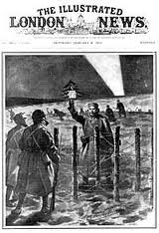
The fighting stopped for nearly two days
The Christmas Truce was very
special and unusual
After the terrible fighting, it was
a special time to think of home
and have some fun playing
football.
Some soldiers even exchanged
presents and ate food together

Slide 5
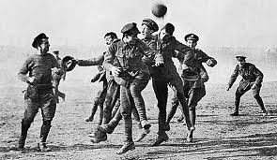
The Football Match
The football match took place on Christmas day 2014.
Germany won two goals to one.

Slide 6
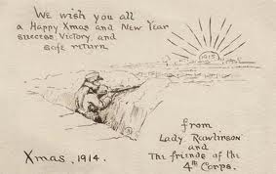
The soldiers received Christmas cards from Britain to try and cheer them up

Slide 7
The Truce stopped on 26th December 1914
The men were ordered back to their trenches by General Sir Horace Smith- Dorrien.
The fighting restarted again.
Many had hoped that the dreadful war would come to an end.
No mans land which had been a meeting ground during the truce was now the battleground again.
Soldiers on both sides remembered it as a happy time in their diaries and postcards home.

Slide 8
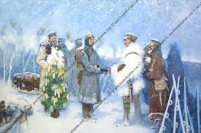
Many artists painted pictures of the Christmas truce and the pictures are often used as Christmas cards today.

