Slide 1
Marching DURING WORLD WAR ONE
1914 to 1918

Slide 2
Men from all over the UK signed up to be soldiers

Slide 3
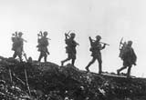
Training to be a Soldier
Men had to be 18 years old
They had to train for 6 weeks
Then they went on a boat
They arrived in France
Then had to march a long way.
They then had to dig their trenches

Slide 4
They had to march in bad weather

Slide 5
THE SOLDIERS HAD TO MARCH FOR A LONG WAYTO START FIGHTING

Slide 6
When they got to their trench, they would have to go over the top to start fighting

Slide 7
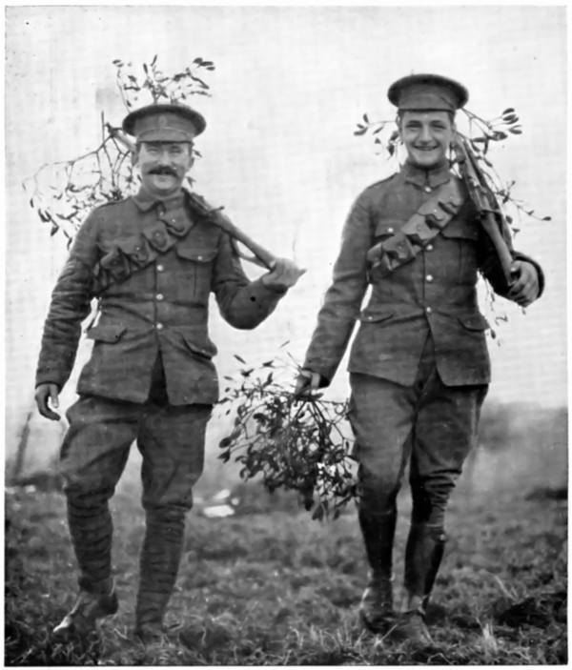
Would you have been able to march a long way ?
Do you think you could march ?
Would you have been a soldier ?
How would you feel ?

